Slide 1
CQ Press Lecture Spark
December 1, 2020
Connecting current events to your International Relations classroom
Notes:
Tags/Categories: Foreign Policy, International Conflict, International Peace, International Development, International Relations
https://www.youtube.com/watch?v=whnylB6ITzs&feature=emb_logo
https://www.youtube.com/watch?v=BiFAQgOC9eA&feature=emb_logo

Slide 2
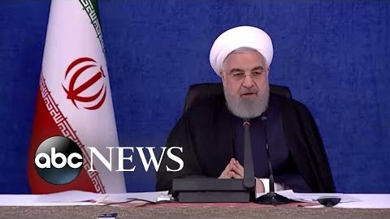
Top Iranian Nuclear Scientist Assassinated
On November 27th, top Iranian nuclear scientist Mohsen Fakhrizadeh was assassinated outside the country's capital of Tehran. He was gunned down in a sophisticated attack that lasted only a few minutes. Mr. Fakhrizadeh was instrumental in the development of Iran’s pursuit of nuclear weapons and was singled out by Israeli Prime Minister Benjamin Netanyahu in 2018 as the mastermind behind Iran’s ongoing attempt to develop nuclear weapons. The Iranian government accuses Israel of carrying out the assassination. What is the significance of this assassination?
Notes:
The following are selected news articles on Fakhrizadeh’s assassination:
Assassinated Iranian nuclear scientist shot with remote-controlled machine gun, news agency says
CNN
November 30, 2020
https://www.cnn.com/2020/11/29/middleeast/iran-mohsen-fakhrizadeh-remote-control-machine-gun/index.html
Iran says nuclear scientist killed by remote-controlled device
THE GUARDIAN
November 30, 2020
https://www.theguardian.com/world/2020/nov/30/iran-says-nuclear-scientist-killed-by-remote-controlled-device
Iran opposition suspected alongside Israel in scientist's killing, Shamkani says
REUTERS
November 30, 2020
https://www.reuters.com/article/iran-nuclear-scientist-israel/iran-opposition-suspected-alongside-israel-in-scientists-killing-shamkani-says-idUSKBN28A0SJ
Rouhani accuses ‘mercenary’ Israel of killing top Iran scientist
AL JAZEERA
November 28, 2020
https://www.aljazeera.com/news/2020/11/28/irans-rouhani-accuses-israel-of-killing-top-iranian-scientist

Slide 3
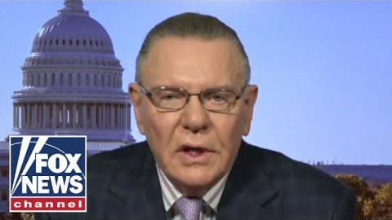
Top Iranian Nuclear Scientist Assassinated
Israeli officials view Iran’s nuclear weapons program as a major threat to their security and survival in part because of Iran’s actions and rhetoric over the last several decades. Arab countries within the region, such as Saudi Arabia, also fear that if Iran possess nuclear weapons it could destabilize the region and lead to an arms race. Iran has vowed revenge against Israel and protesters took to the streets of Tehran demanding justice. It remains unclear how the assassination of Fakhrizadeh will impact U.S. and Iranian relations under a Biden Administration. What are the ramifications if Iran has nuclear weapons?
Notes:
The following are selected news articles on Fakhrizadeh’s assassination:
Mohsen Fakhrizadeh: What were the motives behind his killing?
BBC NEWS
November 29, 2020
https://www.bbc.com/news/world-middle-east-55118140
ANALYSIS: What’s Behind the Assassination of Iran’s Top Nuclear Scientist
ISRAEL TODAY
November 30, 2020
https://www.israeltoday.co.il/read/analysis-whats-behind-the-assassination-of-irans-top-nuclear-scientist/
Analysis: Killing of Nuclear Scientist May Save Countless Lives
WORLD ISRAEL NEWS
November 30, 2020
https://worldisraelnews.com/analysis-killing-of-nuclear-scientist-may-save-countless-lives/
Iran suffers more humiliation with killing of nuclear chief. But no one in the world's most febrile region wants war
CNN
November 28, 2020
https://www.cnn.com/2020/11/28/middleeast/iran-mohsen-fakhrizadeh-killing-analysis-intl/index.html

Slide 4
Background and Key Concepts
Top Iranian nuclear scientist, Mohsen Fakhrizadeh, was assassinated and Israel is widely believed to have carried out the attack.
Israel fears that Iran is moving closer to having operational nuclear weapons that could be used against the Jewish state in the future.
Israeli officials believe that Iran is determined to develop a nuclear weapons program, regardless of any deals or treaties it has signed in the past, such as the 1970 Nuclear Non-Proliferation Treaty or the 2015 Joint Comprehensive Plan of Action (JCPOA).
Iran has threatened to retaliate, and there will be immense public pressure from their own citizens to exact revenge against Israel and perhaps the U.S. as well. At the same time, Iranian officials may have an opportunity to improve relations with the U.S. under a Biden administration.
Overshadowing all of this is President-Elect Biden, who has signaled that he would like the U.S. to rejoin the 2015 (JCPOA) nuclear deal, which was meant to halt Iran’s quest to develop nuclear weapons in exchange for the lifting of sanctions on Iran.

Slide 5
Characteristics of Iran
Name | Population | Government Type | Population Below Poverty Line | Military Expenditures Country Comparison To The World
Iran | 84,923,314 | Theocratic Republic | 18.7% | 16th
Source: CIA WORLD FACTBOOK

Slide 6
Assessment
Writing: Describe why the assassination of Mohsen Fakhrizadeh has the potential to alter U.S. and Iranian relations under a Biden administration.
Debate: The U.S. and the international community should use whatever options exist to prevent Iran from developing nuclear weapons.
Poll: Should Iran have the option of developing nuclear weapons?
Short Answer: What would be the impact if other countries in the region developed and/or acquired nuclear weapons?

