Slide 1
CQ Press Lecture Spark
October 27, 2020
Connecting current events to your International Relations classroom
Notes:
Tags/Categories: Foreign Policy, International Conflict, The Global Economy, International Development, International Relations
https://www.youtube.com/watch?v=2kzvPIVfRQY&feature=emb_logo
https://www.youtube.com/watch?v=eAchDmXxtKE&feature=emb_logo

Slide 2
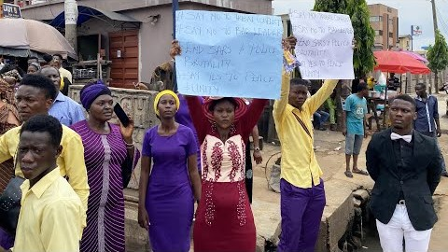
Nigeria Continues to Face Unrest
Earlier this month, Nigerians took to the streets to draw attention to police brutality. At first, protestors wanted the government to dissolve the Special Anti-Robbery Squad (SARs) unit, which has been accused of committing human rights violations. As the demonstrations continued to grow, security forces began to use lethal force against the protesters. This has led to a desire for expanded reforms in society, addressing many long-standing problems that plague Nigeria. What types of reforms are the protesters calling for?
Notes:
The following are selected news articles on unrest in Nigeria:
Nigeria protests: Police chief deploys 'all resources' amid street violence
BBC NEWS
October 25, 2020
https://www.bbc.com/news/world-africa-54678345
Entire Nigerian police force mobilized after days of violent protests that have killed at least 69
THE HILL
October 24, 2020
https://thehill.com/policy/international/africa/522601-entire-nigerian-police-force-mobilized-after-days-of-violent
Nigeria seeks to halt looting amid fury over ‘food warehouses’
AL JAZERRA
October 25, 2020
https://www.aljazeera.com/news/2020/10/25/nigeria-cracks-down-on-rising-mob-looting-on-food-warehouses
"We're here to defend our unity": Nigeria clashes trigger global movement against police brutality
CBS NEWS
October 24, 2020
https://www.cbsnews.com/news/endsars-nigeria-clashes-trigger-global-movement-police-brutality/

Slide 3
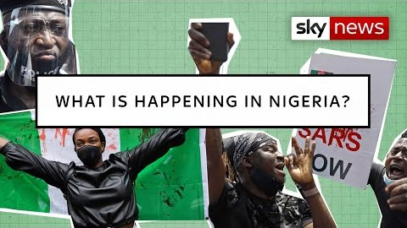
Nigeria Continues to Face Unrest
The protests are the largest in Nigeria in a generation and represent a serious threat to the government. Some demonstrations have turned violent, with looting and property damaged by the street protesters. The movement is largely leaderless and driven by young people who feel as if they have no prospects or ability to improve their economic status. In the last week alone, 69 people have died including protesters, police officers, and soldiers. What are the ramifications if Nigeria becomes a failed state?
Notes:
The following are selected news articles on unrest in Nigeria:
Nigeria's youth finds its voice with the EndSARS protest movement
CNN
October 25, 2020
https://www.cnn.com/2020/10/25/africa/nigeria-end-sars-protests-analysis-intl/index.html
'Hope Is Lost' As Police Open Fire On Pro-Reform Protesters In Lagos, Nigeria
NPR
October 21, 2020
https://www.npr.org/2020/10/21/926163091/hope-is-lost-as-police-open-fire-on-pro-reform-protesters-in-lagos-Nigeria
How the End Sars Protests Have changed Nigeria forever
BBC News
October 24, 2020
https://www.bbc.com/news/world-africa-54662986

Slide 4
Background and Key Concepts
Protests have erupted all over Nigeria as a result of frustration with the government.
There are a multitude of reasons why Nigerians are taking to the streets to voice their concerns.
The initial reason dealt with a desire to shed light on police brutality and end state sanctioned violence. Another reason included economic fears, where unemployment among the population is as high as 27%. In addition, there is widespread belief that the government is corrupt and undemocratic.
In response to the demonstrations, the government has used deadly force which in turn has only heightened the fears and concerns that the situation is spiraling out of control with no end in sight.

Slide 5
CHARACTERISTICS OF NIGERIA
Name | Population | Population below the poverty line | Religion | Literacy
Nigeria | 214,028,302 | 70% | Muslim 54% Roman Catholic 11% Other Christian 35% | 62%
Source: CIA WORLD FACTBOOK

Slide 6
Assessment
Writing: Describe why demonstrators are so unhappy . What can the Nigerian government do to address their concerns?
Debate: The U.S. and the international community should intervene to help promote stability within Nigeria.
Poll: Should protesters in Nigeria use violence to achieve their goals?
Short Answer: What would be the implications if the unrest spread to neighboring countries?

