Slide 1
CQ Press Lecture Spark
October 12, 2020
Connecting current events to your International Relations classroom
Notes:
Tags/Categories: Foreign Policy, International Conflict, International Trade, International Development
https://www.youtube.com/watch?v=5dafVqOdHDo&feature=emb_logo
https://www.youtube.com/watch?v=42PqrMGabPI&feature=emb_logo

Slide 2
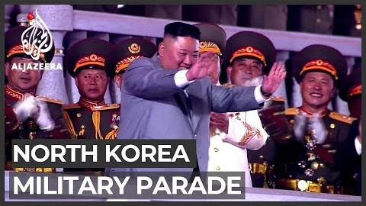
North Korea holds Massive Military Parade
North Korea held perhaps the largest military parade ever in the hermit country’s history to commemorate the 75th anniversary of the ruling Workers’ party. The highly choreographed event marked thousands of troops goose stepping through the capital of Pyongyang, accompanied by tanks and other armored vehicles. The event started with an emotional speech delivered by the leader of the totalitarian state, Kim Jong Un, and ended with the unveiling of the country’s largest and newest intercontinental ballistic missile. What is the significance of North Korea holding such an event?
Notes:
The following are selected news articles on North Korea’s Military Parade:
North Korea: What we know about the 'massive' new missile on parade
BBC NEWS
October 11, 2020
https://www.bbc.com/news/world-asia-54500550
North Korea plans biggest ever military parade for party anniversary – report
THE GUARDIAN
October 9, 2020
https://www.theguardian.com/world/2020/oct/09/north-korea-plans-biggest-ever-military-parade-for-party-anniversary-report
Kim Jong Un Puts New Missiles On Display At Military Parade In North Korea
NPR
October 10, 2020
https://www.npr.org/2020/10/10/922618623/kim-jong-un-puts-new-missiles-on-display-at-military-parade-in-north-korea
North Korea unveils massive new ballistic missile in military parade
CNN
October 10, 2020
https://www.cnn.com/2020/10/10/asia/north-korea-military-parade-new-missiles-intl-hnk/index.html

Slide 3
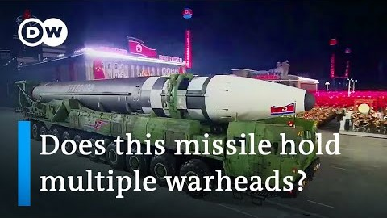
North Korea holds Massive Military Parade
The North Korean military showcased its latest weapon with the display of one of the world’s biggest ballistic missiles. It is unclear whether the missile has been tested. However, the new weaponry allows for North Korea to place multiple nuclear warheads on a single device. Analysts believe that the new intercontinental ballistic missile has the potential to hit much of the U.S. mainland and further creates angst among governments around the world. What would be the implications if North Korea used a nuclear weapon on another country?
Notes:
The following are selected news articles on North Korea’s Military Parade:
North Korea unveils 'monster' new intercontinental ballistic missile at parade
REUTERS
October 9, 2020
https://www.reuters.com/article/us-northkorea-missiles/north-korea-unveils-monster-new-intercontinental-ballistic-missile-at-parade-idUSKBN26V01K
Emergency meeting held in South Korea after North Korea parades new missiles
NBC NEWS
October 11, 2020
https://www.nbcnews.com/news/world/emergency-meeting-held-south-korea-after-north-korea-parades-new-n1242841
South Korea concerned over North’s display of new weaponry
AL JAZEERA
October 11, 2020
https://www.aljazeera.com/news/2020/10/11/south-korea-shows-concerns-over-norths-display-of-new-weaponry
Iran, North Korea had an abysmal 2020 - analysis
THE JERUSALEM POST
October 12, 2020
https://www.jpost.com/middle-east/iran-news/iran-north-korea-had-an-abysmal-2020-analysis-645396

Slide 4
Background and Key Concepts
North Korea has one of the largest militaries and is one of only a handful of countries in the world to possess operational nuclear weapons.
Tensions are high in the region considering North Korea has threatened its neighbors such as South Korea and Japan, in addition to the United States. The fear is that diplomacy will be more difficult to achieve as a result of North Korea brandishing its new military hardware.
North Korea has enhanced and strengthened its position on the world stage with the development of an upgraded intercontinental ballistic missile that can reach most of the West. It poses a real threat to U.S. missile defense systems with its ability to deliver multiple nuclear warheads at once.
There was optimism early in the Trump administration that détente would prevail. However, as nuclear talks have stalled between the United States and North Korea it increasingly looks unlikely that any type of agreement can occur.

Slide 5
Characteristics of North Korea
Name | Ally of | Population | Military Size | Has Nuclear Weapons
North Korea | China & Russia | 25, 643,466 | 1.2 million active troops | Yes
Source: CIA WORLD FACTBOOK

Slide 6
Assessment
Writing: What is the best way to achieve stability on the Korean peninsula? How should the international community go about getting North Korea to end its nuclear weapons program?
Debate: Is it right for the U.S. and other nuclear countries to pressure North Korea to denuclearize?
Poll: Should the U.S. and its allies use force to create regime change in North Korea?
Short Answer: What would be the consequences if North Korea and the United States get into a military conflict?

