Slide 1
CQ Press Lecture Spark
December 2, 2019
Connecting current events to your American Government classroom
Notes:
Categories – American Government, Texas State Politics, Environmental Policy
Tags – Chemical Plant Explosion, Industry Regulations, Health and Human Safety, Air Quality
Video # 1: https://www.youtube.com/watch?v=rMvi5tdHWIw
Video #2: https://www.youtube.com/watch?v=ivvIkpTgcvI

Slide 2
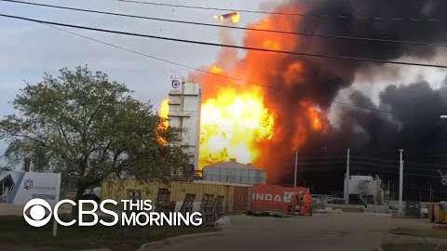
Explosions Rock Texas Chemical Plant
On November 27, the day before Thanksgiving, Port Neches, TX was rocked by two major explosions at a chemical/petroleum refinery. The explosions injured three people, blew out windows in the surrounding neighborhoods, and prompted officials to evacuate nearly 60,000 local residents amid air quality concerns. What can the EPA do to ensure such disasters are prevented in the future?
Notes:
The following are selected news articles on the Thanksgiving Explosions at Texas Chemical Plant:
TPC plant called ‘high priority violators’ by EPA before explosion
ABC 13
Published on November 28, 2019
https://abc13.com/plant-called-high-priority-violators-by-epa-before-blast/5723404/
EPA records show Port Neches plant rocked by explosion had history of ‘preventable’ emissions
KMBT 12 News
Published on November 28, 2019
https://www.12newsnow.com/article/news/local/power-city/epa-records-show-port-neches-plant-rocked-by-explosions-had-history-of-preventable-emissions/502-3169ce87-3b28-49b7-b3a6-ed5af6cc7173
Explosions Shake a Texas Town, and Its View on Thanksgiving
The New York Times
Published on November 28, 2019
https://www.nytimes.com/2019/11/28/us/port-neches-texas-explosion.html
Explosions Rock Chemical Plant in Texas, Prompting Mass Evacuations
Huffington Post
Published on November 27, 2019
https://www.huffpost.com/entry/texas-chemical-plant-explosion_n_5ddf162ce4b0d50f329c2007?guccounter=1&guce_referrer=aHR0cHM6Ly9uZXdzLmdvb2dsZS5jb20v&guce_referrer_sig=AQAAAIi6mrj0THiHjJ4Oq7A6EDXlsUCdLyx-nHUmomC0qXxkmKRESCXDFARJtpgBI5F5JlO7_vkSLCheJcjt1Ow_XLmrfI9MXmWKGqloQQPyymsVEG_8PW3QT0tO6EjyK3_-WvY1xOkUqd7hkdRyaGlsjpvSmWQfGefZSNCcoPm7bIM1

Slide 3
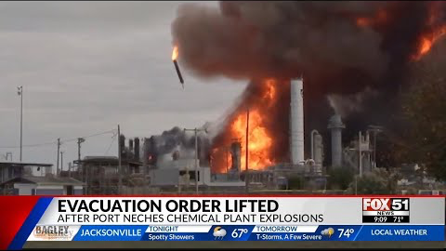
Explosions Rock Texas Chemical Plant
This particular chemical plant had previously been fined by EPA for violating emissions standards and for providing unsafe working conditions for its staff. Under the new Trump-era EPA, several environmental regulations have been rolled back, included regulations on air quality. Could industry deregulation be contributing to unsafe working conditions and increased likelihood of costly accidents?
Notes:
The following pieces provide analyses of the Thanksgiving Explosions at Texas Chemical Plant:
With Port Neches burning, do we really think gutting the EPA is wise?
The Houston Chronicle
Published on November 29, 2019
https://www.houstonchronicle.com/opinion/outlook/article/With-Port-Neches-burning-do-we-really-think-14870909.php
Officials lift evacuation order following TPC plant explosion, fire
KMBT 12 News
Published on November 27, 2019
https://www.12newsnow.com/article/news/local/explosion-fire-burning-at-port-neches-plant-early-wednesday/502-de236827-a796-48f7-ac55-fad5064c3c8b
Chem plant blast was bad, could’ve been a lot worse
Beaumont Enterprise
Published on November 27, 2019
https://www.beaumontenterprise.com/news/article/Chem-plant-blast-was-bad-could-ve-been-a-lot-14867906.php#photo-18677208

Slide 4
Background and Key Concepts
At 1 am on November 27, the day before Thanksgiving, an explosion at a chemical refinery rocked the community of Port Neches. Later that same day, several more blasts shook surrounding neighborhoods.
TPC Group, the Houston-based company running the chemical and petroleum refinery in Port Neches, had previously been fined $180,000 over the past five years for workplace safety infringements and emissions violations.
According to the Texas Commission on Environmental Quality (TCEQ), the blast has released a toxic, odorous compound known to cause eye, nose and throat irritation as well as headaches and nausea.
This latest disaster came just weeks after the Trump administration announced new cut backs to EPA regulatory oversight.

Slide 5
Assessment
Writing: Describe the historic relationship between the EPA and the industrial sector of the U.S. economy. What regulatory power/limitations have been imposed on the agency under the current administration?
Debate: The Environmental Protection Agency should be strengthened and expanded in order to prevent future harm to surrounding communities.
Poll: Should private companies, like TPC, be held more financially responsible for improper safety precautions?
Short Answer: What can the EPA do to ensure that the proper safety measures are met by plants working with toxic and highly flammable materials?

