Slide 1
CQ Press Lecture Spark
December 2, 2019
Connecting current events to your International Relations classroom
Notes:
Categories – International Relations, International Terrorism
Tags – Stabbing, London, England, Islamic Terrorism
Video #1: https://www.youtube.com/watch?v=Mtskm5J7ztM
Video #2: https://www.youtube.com/watch?v=I0FQLQWet6g

Slide 2
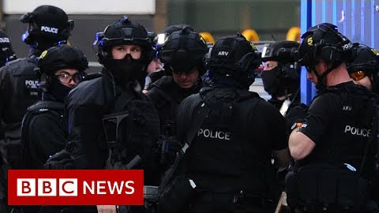
London Bridge Knife Attack
On November 29, 2 people were killed and 3 others were injured in a knife attack near the historic London Bridge. The assailant was overcome by pedestrians and stripped of his deadly weapon until police arrived, who shot and killed the attacker. How can the UK government address the problem of terrorism at its root? Is the solution stricter sentencing? Probation reform? More police?
Notes:
The following are selected news articles on the London Bridge Knife Attack:
London Bridge: Parties row over attacker’s early release
BBC
Published on November 30, 2019
https://www.bbc.com/news/uk-50615928
London Bridge: Who was the attacker?
BBC
Published December 2, 2019
https://www.bbc.com/news/uk-50611788
London Knife Attacker Identified; Public Lauds Narwhal Tusk Takedown
NPR
Published on November 30, 2019
https://www.npr.org/2019/11/30/783850385/london-knife-attacker-identified-public-lauds-narwhal-tusk-takedown
ISIL Claims Responsibility for Deadly London Bridge Attack
Aljazeera
Published on November 30, 2019
https://www.aljazeera.com/news/2019/11/isil-claims-responsibility-deadly-london-bridge-attack-191130174025409.html

Slide 3
London Bridge Knife Attack
Police have identified the attacker as Usman Khan, a member of an Al Qaeda who was charged in 2012 with terrorist activity and sentenced to prison. He was released on parole in 2018. The video makes reference to the need for tougher immigration laws in the US. Is this an appropriate formula to address terrorism concerns? What about the rise of domestic terrorism?
Notes:
The following pieces provide analyses of the London Bridge Knife Attack:
People convicted of terror offenses must serve full prison terms: UK PM
Reuters
Published on November 30, 2019
https://www.reuters.com/article/us-britain-security-johnson-offences/people-convicted-of-terror-offenses-must-serve-full-prison-terms-uk-pm-idUSKBN1Y40CF
Attack by Convicted Terrorist Prompts U.K. to Review Sentencing
The Wall Street Journal
Published on November 30, 2019
https://www.wsj.com/articles/attack-by-convicted-terrorist-prompts-u-k-to-review-sentencing-11575128129
Tougher sentences won’t stop another London Bridge attack, but probation reform and more police might
The Independent
Published on November 30, 2019
https://www.independent.co.uk/voices/london-bridge-attack-terror-tougher-sentences-police-probation-a9227271.html

Slide 4
Background and Key Concepts
The assailant accused of committing the London Bridge attack is a UK citizen and lifelong resident of Stoke-on-Trent, a small British community in Cobridge.
The assailant was under the surveillance of MI5 at the time of the attack and had previously been convicted of terror activity in 2012. However, he was released under parole and supervision in 2018.
The assailant had apparently been radicalized by Al Qaeda.
This attack comes just two and a half years after another series of terror attacks on the city of London resulted in the deadliest year on record.

Slide 5
Assessment
Writing: Review the timeline of terror attacks in England. What has prompted the general increase in activity? What has been the political response to such attacks?
Debate: Individuals convicted of terrorism should face harsher sentencing. Strict sentencing laws will be more effective at reducing terror incidents than probation reform and increasing police presence.
Poll: Should the government impose life-in-prison for convicted terrorists?
Short Answer: What effect, if any, might this attack have on the upcoming parliamentary elections in England?

